Slide 1

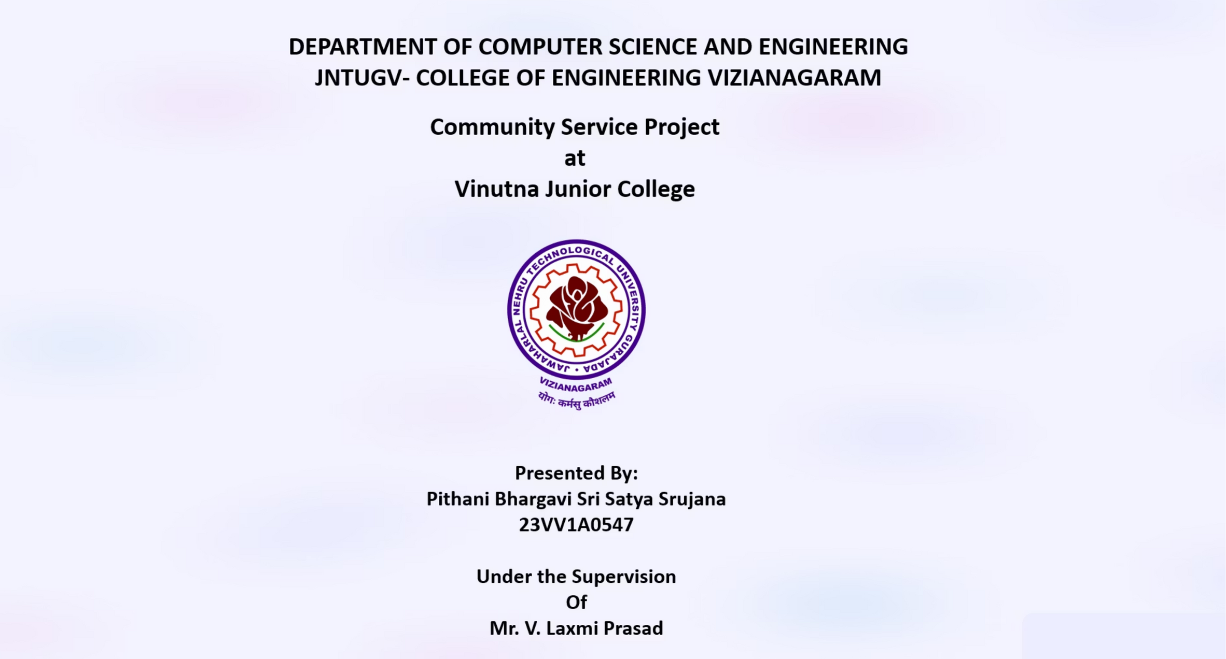

Slide 2
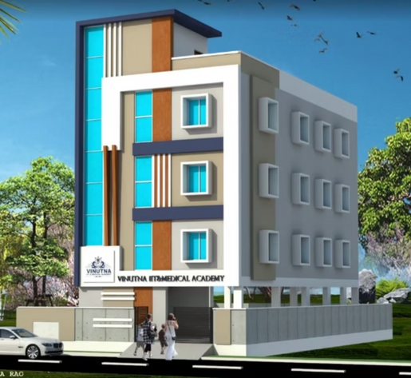
Project Overview
Community Service Project (CSP) — Web Development for Vinutna Junior College, Kakinada. Period: 10‑05‑2025 to 12‑06‑2025. Mentor: Mr. V. Laxmi Prasad.
Purpose
Combine community service with academic learning to improve the college's digital presence and student accessibility.
About Vinutna Junior College
Vinutna Junior College, is a private intermediate college located in Kakinada, Andhra Pradesh. The institution focuses on providing quality education for MPC and BiPC streams, with special coaching for IIT-JEE and NEET entrance exam.

Slide 3
Objectives
Identify Needs
Apply Skills
Identify what the old website is lacking and improve it.
Use HTML, CSS, JavaScript and Express.js to build functional, responsive sites.
Promote Institution,
Enhancing Digital Accessibility
Enhances the college’s digital presence and communication..
Promotes accessibility for students, parents, and faculty

Slide 4



Web Development: Crafting Digital Experiences
Web development blends technical expertise and creative problem-solving to create engaging and functional online platforms.
Frontend Development
Backend Development
Full-Stack Integration
The visible part of a website. Used HTML for structure, CSS for styling, and JavaScript for interactivity.
Server-side logic and database interactions. Utilized Node.js and Express.js for robust APIs.
Combines frontend and backend for a seamless digital experience, ensuring smooth communication.

Slide 5
Project Timeline — 5 Weeks (180 hrs)
Survey
1
10–14 May — Need analysis, content collection, stakeholder interviews.
2
Design
15–19 May — Wireframes, Figma prototypes, tech stack finalised.
Frontend
3
20–25 May — HTML/CSS/JS development, iterative feedback.
4
Backend
26 May–4 June — Express.js server, form handling, Nodemailer integration.
Testing & Deploy
5
5–12 June — Manual testing, Vercel frontend, Render backend, final demo.

Slide 6
Project Accomplishments
Our web development project for Vinutna Junior College delivered a robust, user-friendly online platform, enhancing their digital presence and operational efficiency. Here are the key achievements:
Comprehensive College Website
1
Created essential pages including Home, About, Courses, Hostels, and a dynamic Gallery, providing complete information for prospective students and parents.
Streamlined Application Process
2
Developed a secure "Apply Now" form, integrating Express.js and Nodemailer to ensure efficient and validated submission directly to the college's email.
Responsive & Accessible Design
3
Implemented a fully responsive design, ensuring optimal viewing and interaction across all devices, from desktops to mobile phones, alongside enhanced accessibility features.
Successful Live Deployment
4
Achieved live deployment of the website, with the frontend hosted on Vercel and the backend on Render, making the college's new digital face globally accessible.

Slide 7
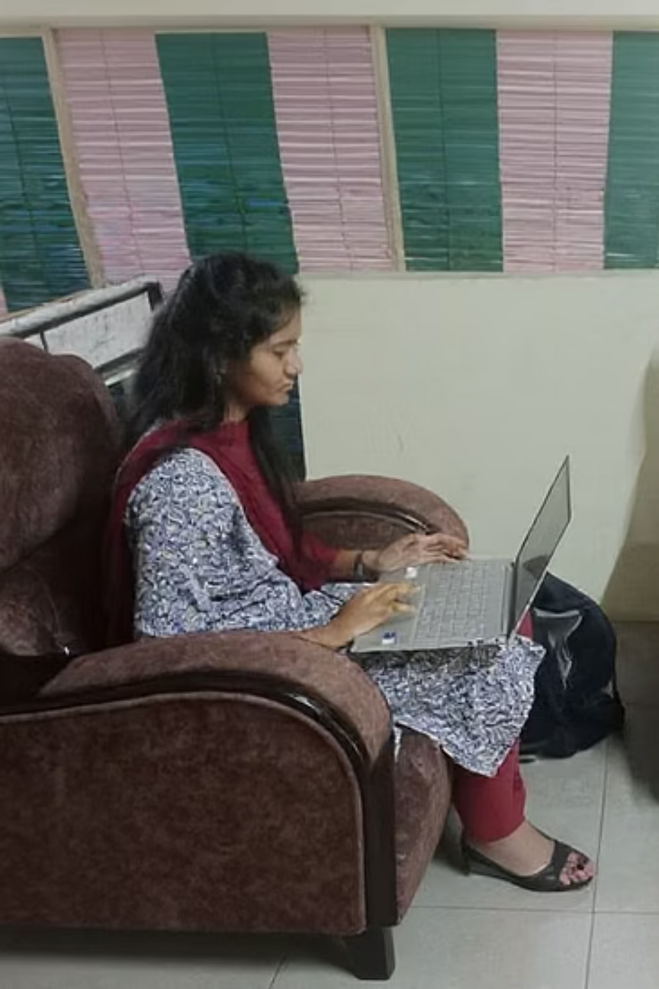

Skills Gained
Life Skills
Technical Skills
Communication
HTML, CSS, JavaScript
Organisation
Express.js
Critical thinking
GitHub, deployment (Vercel, Render)
Patience & active listening
UI/UX planning

Slide 8
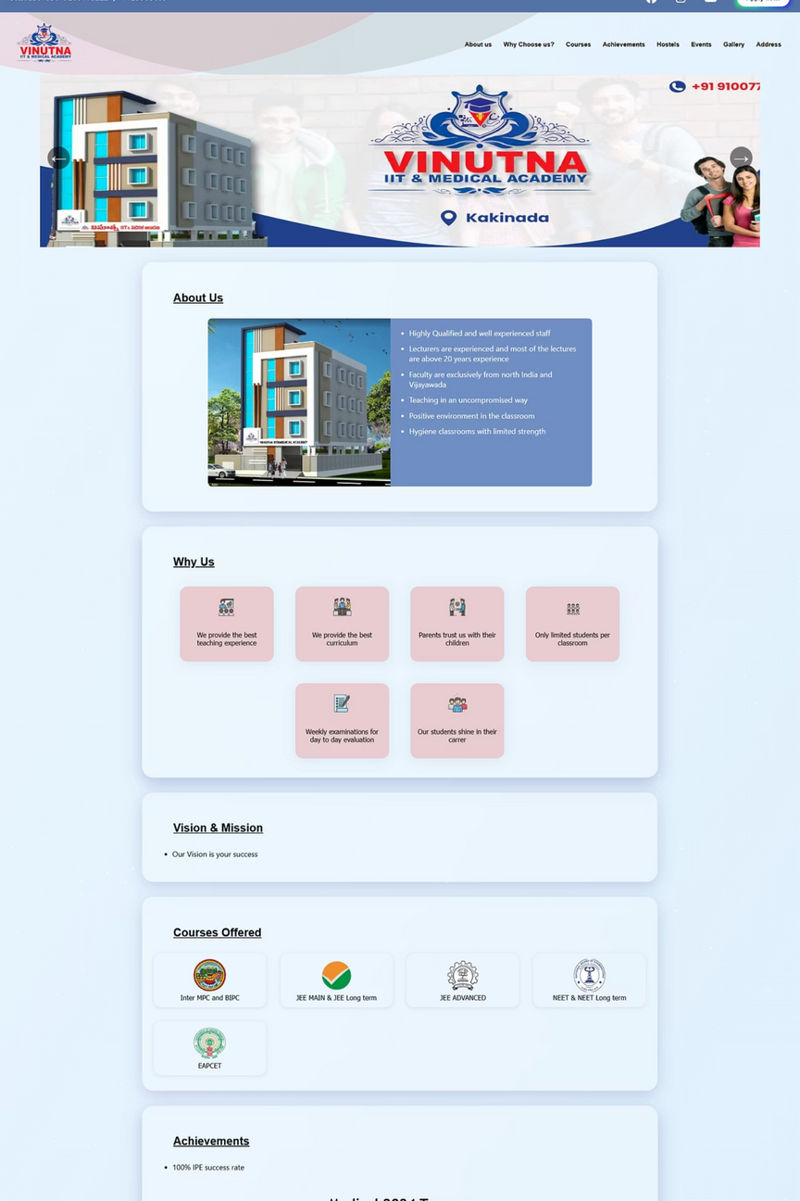
Key Deliverables
College Website
Apply Now Integration
Home, About, Courses, Hostels, Gallery, Apply Now — responsive and accessible.
Form submissions sent to college email via Express.js + Nodemailer with validation.
Live Deployment
Frontend hosted on Vercel; backend hosted on Render; live demo to Director completed.

